Slide 1

Management
Fourteenth Edition
Chapter 13
Creating and Managing Teams
Copyright © 2018, 2016, 2014 Pearson Education, Inc. All Rights Reserved

Slide 2
Learning Objectives
13.1 Define groups and the stages of group development.
13.2 Describe the major components that determine group performance and satisfaction.
13.3 Define teams and best practices influencing team performance.
Know how to maximize outcomes through effective negotiations.
Develop your skill at coaching team members.
13.4 Discuss contemporary issues in managing teams.

Slide 3
Introduction
You’ve probably had a lot of experience working in groups—class project teams, maybe an athletic team, a fundraising committee, or even a sales team at work.
Many organizations have made the move to restructure work around teams rather than individuals. Why?
What do these teams look like?
And how can managers build effective teams?

Slide 4
What is a Group?
Group: two or more interacting and interdependent individuals who come together to achieve specific goals
Formal groups
Informal groups
Notes:
A group is defined as two or more interacting and interdependent individuals who come together to achieve specific goals. Formal groups are work groups defined by the organization’s structure and have designated work assignments and specific tasks directed at accomplishing organizational goals.
Informal groups are social groups. These groups occur naturally in the workplace and tend to form around friendships and common interests. For example, five employees from different departments who regularly eat lunch together are an informal group.

Slide 5
Formal groups are work groups defined by the organization’s structure and have designated work assignments and specific tasks directed at accomplishing organizational goals.
Informal groups are social groups. These groups occur naturally in the workplace and tend to form around friendships and common interests. For example, five employees from different departments who regularly eat lunch together are an informal group

Slide 6
Exhibit 13-1 Examples of Formal Work Groups
Group | Description
Command groups | Groups determined by the organizational chart and composed of individuals who report directly to a given manager.
Task groups | Groups composed of individuals brought together to complete a specific job task; their existence is often temporary because when the task is completed, the group disbands.
Cross-functional teams | Groups that bring together the knowledge and skills of individuals from various work areas or groups whose members have been trained to do each others’ jobs.
Self-managed teams | Groups that are essentially independent and that, in addition to their own tasks, take on traditional managerial responsibilities such as hiring, planning and scheduling, and evaluating performance.
Notes:
Exhibit 13-1 provides some examples of formal groups.

Slide 7
Stages of Group Development (1 of 2)
1. Forming: the first stage of group development in which people join the group and then define the group’s purpose, structure, and leadership
2. Storming: the second stage of group development, characterized by intragroup conflict
3. Norming: the third stage of group development, characterized by close relationships and cohesiveness
Notes:
Research shows that groups develop through five stages:
The forming stage has two phases. The first occurs as people join the group. In a formal group, people join because of some work assignment. Once they’ve joined, the second phase begins: defining the group’s purpose, structure, and leadership.
The storming stage is appropriately named because of the intragroup conflict. There’s conflict over who will control the group and what the group needs to be doing. During this stage, a relatively clear hierarchy of leadership and agreement on the group’s direction emerge.
The norming stage is one in which close relationships develop and the group becomes cohesive. There’s now a strong sense of group identity and camaraderie. This stage is complete when the group structure solidifies and the group has assimilated a common set of expectations (or norms) regarding member behavior.

Slide 8
Stages of Group Development (2 of 2)
4. Performing: the fourth stage of group development when the group is fully functional and works on group task
5. Adjourning: the final stage of group development for temporary groups during which group members are concerned with wrapping up activities rather than task performance
Notes:
The fourth stage is the performing stage. The group structure is in place and accepted by group members. Their energies have moved from getting to know and understand each other to working on the group’s task. This is the last stage of development for permanent work groups.
For temporary groups—project teams, task forces, or similar groups that have a limited task to do—the final stage is adjourning. In this stage, the group prepares to disband. The group focuses its attention on wrapping up activities instead of task performance.

Slide 9
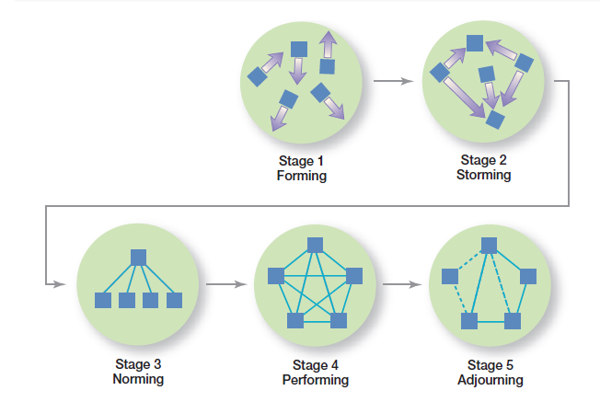
Exhibit 13-2 Stages of Group Development
As shown in Exhibit 13-2, the stages of group development are forming, storming, norming, performing, and adjourning.

Slide 10
LO 2. WORK group performance and satisfaction
Why are some groups more successful than others?
Why do some groups achieve high levels of performance and high levels of member satisfaction and others do not?
The answers are complex, but include variables such as the abilities of the group’s members,
the size of the group,
the level of conflict, and
the internal pressures on members to conform to the group’s norms

Slide 11
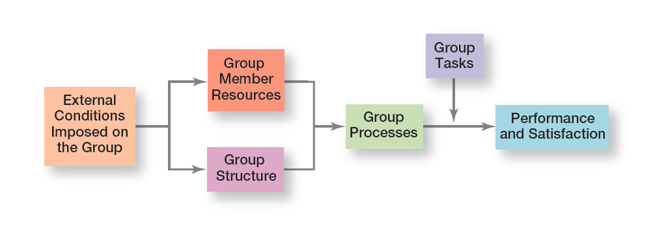
Exhibit 13-3 Group Performance/Satisfaction Model
Exhibit 13-3 presents the major factors that determine group performance and satisfaction.

Slide 12
External Conditions Imposed on the Group
External conditions include:
Organization's strategy
Authority relationships
Formal rules and regulations
Availability of resources
Employee selection criteria
For example, in Japan, kaizen is de€ned as continuous improvement, and most Japanese companies create temporary teams to improve business processes
Notes:
Work groups are affected by the external conditions imposed on it such as the organization’s strategy, authority relationships, formal rules and regulations, availability of resources, employee selection criteria, the performance management system and culture, and the general physical layout of the group’s work space.

Slide 13
Group Member Resources
Knowledge
Abilities
Skills
Personality traits
Research has shown that traits viewed as positive in our culture (such as sociability, self-reliance, and independence) tend to be positively related to group productivity and morale
Notes:
A group’s performance potential depends to a large extent on the resources each individual brings to the group. These resources include knowledge, abilities, skills, and personality traits, and they determine what members can do and how effectively they will perform in a group. Interpersonal skills—especially conflict management and resolution, collaborative problem solving, and communication—consistently emerge as important for high performance by work groups.

Slide 14
Group Structure
Work groups aren’t unorganized crowds. They have an internal structure that shapes members’ behavior and influences group performance. The structure defines roles, norms, conformity, status systems, group size, group cohesiveness, and leadership.
Role: behavior patterns expected of someone occupying a given position in a social unit.
A problem arises when individuals play multiple roles and adjust their roles to the group to which they belong at the time. However, the diering expectations of these roles often means that employees face role conflicts

Slide 15
Group Structure (1 of 2)
Norms: standards or expectations that are accepted and shared by a group’s members
common organizational norms focus on eort and performance, dress, and loyalty.
Conformity:
Groupthink: when a group exerts extensive pressure on an individual to align his or her opinion with others’ opinions
Notes:
A role refers to behavior patterns expected of someone occupying a given position in a social unit. In a group, individuals are expected to do certain things because of their position (role) in the group. These roles are generally oriented toward either getting work done or keeping group members happy.
All groups have norms—standards or expectations that are accepted and shared by a group’s members. Norms dictate things such as work output levels, absenteeism, promptness, and the amount of socializing on the job.
Because individuals want to be accepted by groups to which they belong, they’re susceptible to pressures to conform. But conformity can go too far, especially when an individual’s opinion differs significantly from that of others in the group. In such a case, the group often exerts intense pressure on the individual to align his or her opinion to conform to others’ opinions, a phenomenon known as groupthink. Groupthink seems to occur when group members hold a positive group image they want to protect and when the group perceives a collective threat to this positive image.

Slide 16

Exhibit 13-4 Examples of Asch’s Cards
Exhibit 13-4 presents examples of Asch’s cards.
Notes:
Early experiments done by Solomon Asch demonstrated the impact conformity has on an individual’s judgment and attitudes. In these experiments, groups of seven or eight people were asked to compare two cards held up by the experimenter. One card had three lines of different lengths and the other had one line that was equal in length to one of the three lines on the other card (see Exhibit 13-4). Each group member was to announce aloud which of the three lines matched the single line. Asch wanted to see what would happen if members began to give incorrect answers. Would pressures to conform cause individuals to give wrong answers just to be consistent with the others? The experiment was “fixed” so that all but one of the members (the unsuspecting subject) were told ahead of time to start giving obviously incorrect answers after one or two rounds. Over many experiments and trials, the unsuspecting subject conformed over a third of the time.

Slide 17
Group Structure (2 of 2)
Status systems:
Status: a prestige grading, position, or rank within a group
Group size:
Social loafing: the tendency for individuals to expend less effort when working collectively than when working individually
Group cohesiveness: the degree to which group members are attracted to one another and share the group’s goals
Notes:
A role refers to behavior patterns expected of someone occupying a given position in a social unit. In a group, individuals are expected to do certain things because of their position (role) in the group. These roles are generally oriented toward either getting work done or keeping group members happy.
All groups have norms—standards or expectations that are accepted and shared by a group’s members. Norms dictate things such as work output levels, absenteeism, promptness, and the amount of socializing on the job.
Because individuals want to be accepted by groups to which they belong, they’re susceptible to pressures to conform. But conformity can go too far, especially when an individual’s opinion differs significantly from that of others in the group. In such a case, the group often exerts intense pressure on the individual to align his or her opinion to conform to others’ opinions, a phenomenon known as groupthink. Groupthink seems to occur when group members hold a positive group image they want to protect and when the group perceives a collective threat to this positive image.

Slide 18
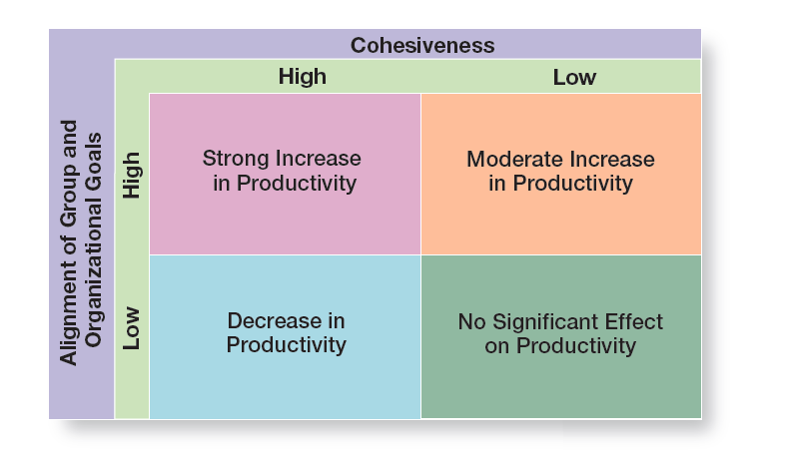
Exhibit 13-5 Group Cohesiveness and Productivity
Exhibit 13-5 represents the relationship between cohesiveness and effectiveness.
Notes:
Research has generally shown that highly cohesive groups are more effective than are less cohesive ones. However, the relationship between cohesiveness and effectiveness is complex. A key moderating variable is the degree to which the group’s attitude aligns with its goals or with the goals of the organization. (See Exhibit 13-5.)

Slide 19
Group Processes: Decision-Making
Advantages:
Generate more complete information and knowledge
Increase acceptance of a solution
Increase legitimacy
Disadvantages:
Take more time
A dominant minority can unduly influence outcome; groupthink
Individual responsibilities are ambiguous
Notes:
Studies show that managers may spend up to 30 hours a week in group meetings. Undoubtedly, a large portion of that time is spent formulating problems, developing solutions, and determining how to implement the solutions. It’s possible, in fact, for groups to be assigned any of the eight steps in the decision-making process.
What advantages do group decisions have over individual decisions? One is that groups generate more complete information and knowledge. They bring a diversity of experience and perspectives to the decision process that an individual cannot. In addition, groups generate more diverse alternatives because they have a greater amount and diversity of information. Next, groups increase acceptance of a solution. Group members are reluctant to fight or undermine a decision they helped develop. Finally, groups increase legitimacy. Decisions made by groups may be perceived as more legitimate than decisions made by one person.
Group decisions also have disadvantages. One is that groups almost always take more time to reach a solution than it would take an individual. Another is that a dominant and vocal minority can heavily influence the final decision. In addition, groupthink can undermine critical thinking in the group and harm the quality of the final decision. Finally, in a group, members share responsibility, but the responsibility of any single member is ambiguous.

Slide 20
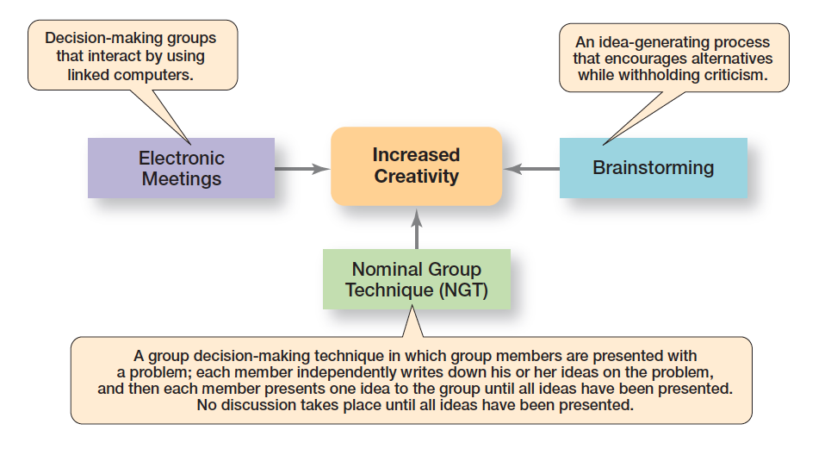
Exhibit 13-6 Creative Group Decision Making
Exhibit 13-6 represents three techniques managers can use to help groups make more creative decisions.
Notes:
What techniques can managers use to help groups make more creative decisions? Exhibit 13-6 describes three possibilities.

Slide 21
Group Processes: Conflict Management
Conflict: perceived incompatible differences that result in interference or opposition
Traditional view of conflict: the view that all conflict is bad and must be avoided
Human relations view of conflict: the view that conflict is a natural and inevitable outcome in any group
Notes:
Conflict is perceived incompatible differences resulting in some form of interference or opposition. Whether the differences are real is irrelevant. If people in a group perceive that differences exist, then there is conflict.
The traditional view of conflict argues that conflict must be avoided—that it indicates a problem within the group. Another view, the human relations view of conflict, argues that conflict is a natural and inevitable outcome in any group and need not be negative but has the potential to be a positive force in contributing to a group’s performance.

Slide 22
Interactionist View of Conflict
Interactionist view of conflict: the view that some conflict is necessary for a group to perform effectively
Functional conflicts: conflicts that support a group’s goals and improve its performance
Dysfunctional conflicts: conflicts that prevent a group from achieving its goals
Notes:
The third and most recent view, the interactionist view of conflict, proposes that not only can conflict be a positive force in a group but that some conflict is absolutely necessary for a group to perform effectively.
The interactionist view doesn’t suggest that all conflicts are good. Some conflicts—functional conflicts—are constructive and support the goals of the work group and improve its performance. Other conflicts—dysfunctional conflicts—are destructive and prevent a group from achieving its goals.

Slide 23
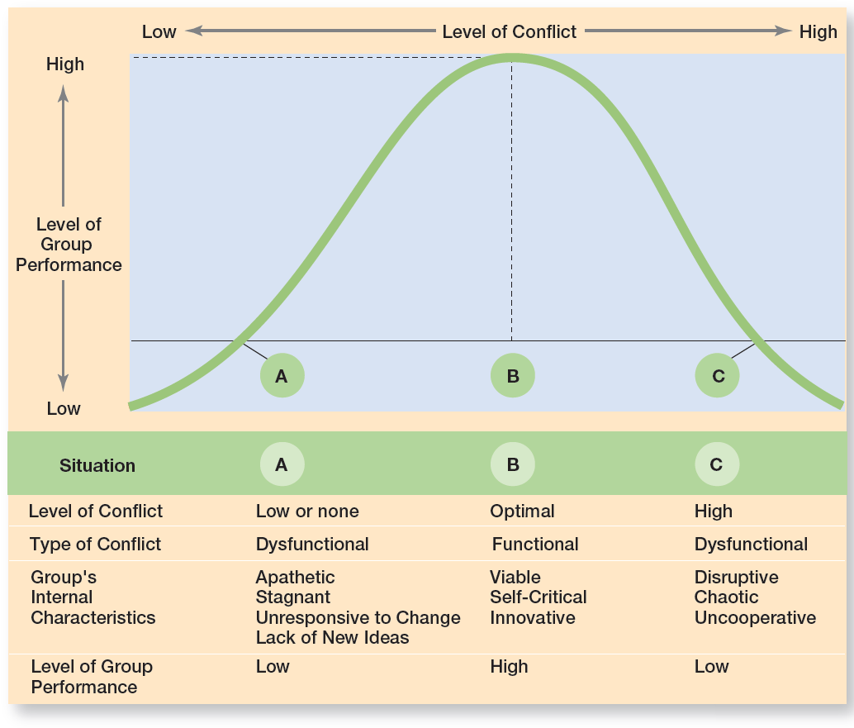
Exhibit 13-7 Conflict and Group Performance
Exhibit 13-7 illustrates the challenge facing managers.

Slide 24
Types of Conflict
Task conflict: conflict over content and goals of the work
Relationship conflict: conflict based on interpersonal relationships
Process conflict: conflict over how work gets done
Notes:
Task conflict relates to the content and goals of the work. Relationship conflict focuses on interpersonal relationships.
Process conflict refers to how the work gets done. Research shows that relationship conflicts are almost always dysfunctional because the interpersonal hostilities increase personality clashes and decrease mutual understanding and the tasks don’t get done. On the other hand, low levels of process conflict and low-to-moderate levels of task conflict are functional. For process conflict to be productive, it must be minimal.
Otherwise, intense arguments over who should do what may become dysfunctional and can lead to uncertainty about task assignments, increase the time to complete tasks, and result in members working at cross-purposes.

Slide 25
Group Tasks
It’s the complexity and interdependence of tasks that influence a group’s effectiveness.
Notes:
As the group performance/satisfaction model shows, the impact that group processes have on group performance and member satisfaction is modified by the task the group is doing. More specifically, it’s the complexity and interdependence of tasks that influence a group’s effectiveness.
Tasks are either simple or complex. Simple tasks are routine and standardized. Complex tasks tend to be novel or nonroutine. It appears that the more complex the task, the more a group benefits from group discussion about alternative work methods.
A high degree of interdependence among the tasks that group members must perform means they’ll need to interact more. Thus, effective communication and controlled conflict are most relevant to group performance when tasks are complex and interdependent.

Slide 26
L03, TURNING groups into efective teams
Without a doubt, team-based work is a core feature of today’s organizations. And teams are likely to continue to be popular. Why?
Research suggests that teams typically outperform individuals when the tasks being done require multiple skills, judgment, and experience. Organizations are using team-based structures because they’ve found that teams are more flexible and responsive to changing events than traditional departments or other permanent work groups. Teams have the ability to quickly assemble, deploy, refocus, and disband.

Slide 27
The Difference Between Groups and Teams
Work teams: groups whose members work intensely on a specific, common goal using their positive synergy, individual and mutual accountability, and complementary skills
Notes:
Most of you are probably familiar with teams, especially if you’ve watched or participated in organized sports events. Work teams differ from work groups and have their own unique traits (see Exhibit 13-8). Work groups interact primarily to share information and to make decisions to help each member do his or her job more efficiently and effectively.
There’s no need or opportunity for work groups to engage in collective work that requires joint effort. On the other hand, work teams are groups whose members work intensely on a specific, common goal using their positive synergy, individual and mutual accountability, and complementary skills.

Slide 28
Exhibit 13-8: Groups Versus Teams
Work Teams | Work Groups
Leadership role is shared | One leader clearly in charge
Accountable to self and team | Accountable only to self
Team creates specific purpose | Purpose is same as broader organizational purpose
Work is done collectively | Work is done individually
Meetings characterized by open-ended discussion and collaborative problem-solving | Meetings characterized by efficiency; no collaboration or open-ended discussion
Performance is measured directly by evaluating collective work output | Performance is measured indirectly according to its influence on others
Work is decided upon and done together | Work is decided upon by group leader and delegated to individual group members
Can be quickly assembled, deployed, refocused, and disbanded | blank
Notes:
Sources: J. R. Katzenbach and D. K. Smith, “The Wisdom of Teams,” Harvard Business Review, July–August 2005, p. 161; A. J. Fazzari and J. B. Mosca, “Partners in Perfection: Human Resources Facilitating Creation and Ongoing Implementation
of Self-Managed Manufacturing Teams in a Small Medium Enterprise,” Human Resource Development Quarterly, Fall 2009, pp. 353–376.

Slide 29
Types of Work Teams (1 of 2)
Problem solving team: a team from the same department or functional area that’s involved in e fforts to improve work activities or to solve specific problems
Self-managed work team: a type of work team that operates without a manager and is responsible for a complete work process or segment
Notes:
When work teams first became popular, most were problem-solving teams, teams from the same department or functional area involved in efforts to improve work activities or to solve specific problems. Members share ideas or offer suggestions on how work processes and methods can be improved. However, these teams are rarely given the authority to implement any of their suggested actions.
Although problem-solving teams were helpful, they didn’t go far enough in getting employees involved in work-related decisions and processes. This shortcoming led to another type of team, a self-managed work team, a formal group of employees who operate without a manager and are responsible for a complete work process or segment. A self-managed team is responsible for getting the work done and for managing themselves, which usually includes planning and scheduling of work, assigning tasks to members, collective control over the pace of work, making operating decisions, and taking action on problems.

Slide 30
Types of Work Teams (2 of 2)
Cross-functional team: a work team composed of individuals from various functional specialties
Virtual team: a type of work team that uses technology to link physically dispersed members in order to achieve a common goal
Notes:
The third type of team is the cross-functional team which is a work team composed of individuals from various functional specialties. Many organizations use cross-functional teams.
The final type of team is the virtual team, a team that uses technology to link physically dispersed members to achieve a common goal. In a virtual team, members collaborate online with tools such as wide-area networks, videoconferencing, fax, e-mail, or Web sites where the team can hold online conferences. Virtual teams can do all the things that other teams can—share information, make decisions, and complete tasks; however, they lack the normal give-and-take of face-to-face discussions.

Slide 31
Creating Effective Work Teams (1 of 2)
Clear goals
Relevant skills
Mutual trust
Unified commitment
Notes:
However, research on teams provides insights into the characteristics typically associated with effective teams.
High-performance teams have a clear understanding of the goal to be achieved. Members are committed to the team’s goals, know what they’re expected to accomplish, and understand how they will work together to achieve these goals.
Effective teams are composed of competent individuals who have the necessary technical and interpersonal skills to achieve the desired goals while working well together. This last point is important because not everyone who is technically competent has the interpersonal skills to work well as a team member.
Effective teams are characterized by high mutual trust among members. That is, members believe in each other’s ability, character, and integrity. But as you probably know from personal relationships, trust is fragile. Maintaining this trust requires careful attention by managers.
Unified commitment is characterized by dedication to the team’s goals and a willingness to expend extraordinary amounts of energy to achieve them. Members of an effective team exhibit intense loyalty and dedication to the team and are willing to do whatever it takes to help their team succeed.

Slide 32
Creating Effective Work Teams (2 of 2)
Good communication
Negotiating skills
Appropriate leadership
Internal and external support
Notes:
Not surprisingly, effective teams are characterized by good communication. Members convey messages, verbally and nonverbally, between each other in ways that are readily and clearly understood. Also, feedback helps guide team members and correct misunderstandings.
Effective teams are continually making adjustments to whom does what. This flexibility requires team members to possess negotiating skills. Because problems and relationships regularly change within teams, members need to be able to confront and reconcile differences.
Effective leaders are important. They can motivate a team to follow them through the most difficult situations. How? By clarifying goals,
demonstrating that change is possible by overcoming inertia, increasing the self-confidence of team members, and helping members to more fully realize their potential. Increasingly, effective team leaders act as coaches and facilitators. They help guide and support the team, but don’t control it. Studies have shown that when a team leader’s emotional displays—positive and negative—are used at appropriate times, the team’s functioning and performance can be enhanced.

Slide 33
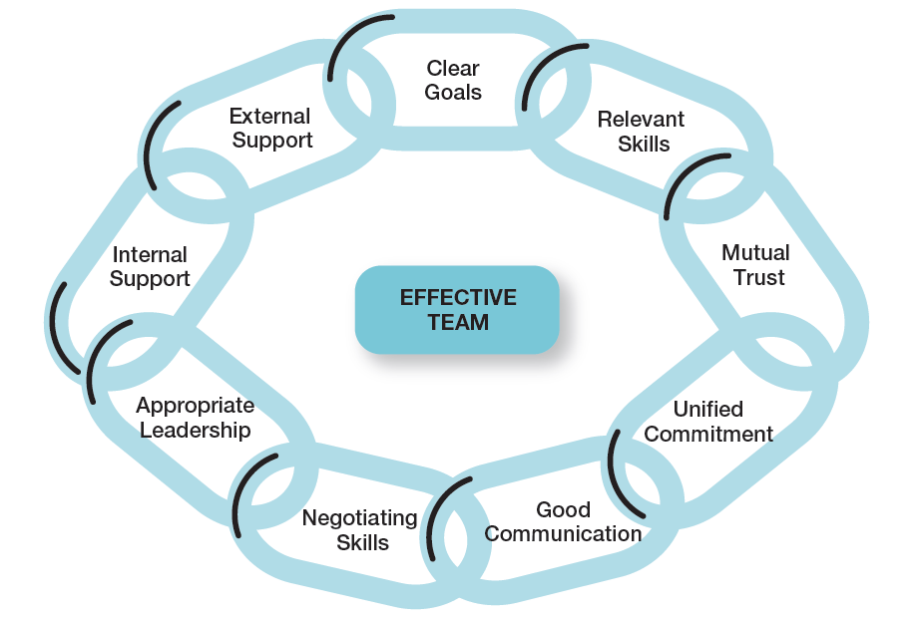
Exhibit 13-9 Characteristics of Effective Teams
Exhibit 13-9 illustrates the characteristics typically exhibited with effective teams.
Notes:
Research on teams provides insights into the characteristics typically associated with effective teams. These characteristics are listed in Exhibit 13-9.

Slide 34
L04. CONTEMPORARY challenges in managing teams
Few trends have influenced how work gets done in organizations as much as the use of work teams. The shift from working alone to working on teams requires employees to cooperate with others, share information, confront differences, and sublimate personal interests for the greater good of the team.

Slide 35
Managing Global Teams
Group member resources in global teams
Group structure
Group processes
Manager’s role
Notes:
In global organizations, understanding the relationship between group performance and group member resources is more challenging because of the unique cultural characteristics represented by members of a global team. In addition to recognizing team members’ abilities, skills, knowledge, and personality, managers need to be familiar with and clearly understand the cultural characteristics of the groups and the group members they manage.
Some of the structural areas where we see differences in managing global teams include conformity, status, social loafing, and cohesiveness. Are conformity findings generalizable across cultures? Research suggests that Asch’s findings are culture-bound. For instance, as might be expected, conformity to social norms tends to be higher in collectivistic cultures than in individualistic cultures. Despite this tendency, however, groupthink tends to be less of a problem in global teams because members are less likely to feel pressured to conform to the ideas, conclusions, and decisions of the group.
The processes global teams use to do their work can be particularly challenging for managers. For one thing, communication issues often arise because not all team members may be fluent in the team’s working language. This can lead to inaccuracies, misunderstandings, and inefficiencies. However, research also has shown that a multicultural global team is better able to capitalize on the diversity of ideas represented if a wide range of information is used.
Despite the challenges associated with managing global teams, managers can provide the group with an environment in which efficiency and effectiveness are enhanced.

Slide 36
Exhibit 13-10: Global Teams
Drawbacks | Benefits
Dislike of team members | Greater diversity of ideas
Mistrust of team members | Limited groupthink
Stereotyping | Increased attention on understanding others’ ideas, perspectives, etc.
Communication problems | blank
Stress and tension | blank
Notes:
Source: Based on N. Adler, International Dimensions in Organizational Behavior, 4th ed. (Cincinnati, OH: South-Western Publishing, 2002), pp. 141–147.

Slide 37
Building Team Skills
In building team skills, managers must view their role as more of being a coach and developing team members in order to create more committed, collaborative, and inclusive teams.
Notes:
With the emphasis on teams in today’s organizations, managers need to recognize that people don’t automatically know how to be part of a team or to be an effective team member. Like any behavior, sometimes you have to learn about the skill and then keep practicing and reinforcing it. In building team skills, managers must view their role as more of being a coach and developing team members in order to create more committed, collaborative, and inclusive teams. It’s important to recognize that not everyone is a team player or can learn to be a team player. If attempts at team building aren’t working, then maybe it’s better to put those people in positions where their work is done individually.

Slide 38
Understanding Social Networks
Social network structure: the patterns of informal connections among individuals within a group
Notes:
We can’t leave this chapter on managing teams without looking at the patterns of informal connections among individuals within groups—that is, at the social network structure. What actually happens within groups? How do group members relate to each other and how does work get done? Managers need to understand the social networks and social relationships of work groups. Why? Because a group’s informal social relationships can help or hinder its effectiveness.

Slide 39
Review Learning Objective 13.1
Define groups and the stages of group development.
Formal/informal groups
Stages of group development:
Forming
Storming
Norming
Performing
Adjourning
Notes:
A group is two or more interacting and interdependent individuals who come together to achieve specific goals. Formal groups are work groups defined by the organization’s structure and have designated work assignments and specific tasks directed at accomplishing organizational goals. Informal groups are social groups.
The forming stage consists of two phases: joining the group and defining the group’s purpose, structure, and leadership. The storming stage is one of intragroup conflict over who will control the group and what the group will be doing. The norming stage is when close relationships and cohesiveness develop as norms are determined. The performing stage is when group members begin to work on the group’s task. The adjourning stage is when the group prepares to disband

Slide 40
Review Learning Objective 13.2
Describe the major components that determine group performance and satisfaction.
External conditions and group member resources affect work group performance
Group decision making
Conflict management
Notes:
The major components that determine group performance and satisfaction include external conditions, group member resources, group structure, group processes, and group tasks. External conditions, such as availability of resources, organizational goals, and other factors, affect work groups. Group member resources (knowledge, skills, abilities, personality traits) can influence what members can do and how effectively they will perform in a group.
Pressures to conform can heavily influence a person’s judgment and attitudes. If carried to extremes, groupthink can be a problem. Status systems can be a significant motivator with individual behavioral consequences, especially if incongruence is a factor. What size group is most effective and efficient depends on the task the group is supposed to accomplish. Cohesiveness is related to a group’s productivity.
Characteristics of work groups include a strong, clearly focused leader; individual accountability; purpose that’s the same as the broader organizational mission; individual work product; efficient meetings; effectiveness measured by influence on others; and discusses, decides, and delegates together.

Slide 41
Review Learning Objective 13.3
Define teams and best practices influencing team performance.
Managing global teams
Building team skills
Understanding social networks
Notes:
The challenges of managing global teams can be seen in the group member resources, especially the diverse cultural characteristics; group structure, especially conformity, status, social loafing, and cohesiveness; group processes, especially with communication and managing conflict; and the manager’s role in making it all work.
With the emphasis on teams in today’s organizations, managers need to recognize that people don’t automatically know how to be part of a team or to be an effective team member. Like any behavior, team members have to learn about the skill and then keep practicing and reinforcing it. In building team skills, managers must view their role as more of being a coach and developing others to create more committed, collaborative, and inclusive teams.
Managers need to understand the patterns of informal connections among individuals within groups because those informal social relationships can help or hinder the group’s effectiveness.

Slide 42
Review Learning Objective 13.4
Discuss contemporary issues in managing teams.
The 12 common decision-making errors and biases:
Overconfidence
Immediate gratification
Anchoring effect
Notes:
The 12 common decision-making errors and biases include overconfidence, immediate gratification, anchoring, selective perception, confirmation, framing, availability, representation, randomness, sunk costs, self-serving bias, and hindsight. The managerial decision-making model helps explain how the decision-making process is used to choose the best alternative(s), either through maximizing or Satisficing and then implement and evaluate the alternative. It also helps explain what factors affect the decision-making process, including the decision-making approach (rationality, bounded rationality, intuition), the types of problems and decisions (well structured and programmed or unstructured and nonprogrammed), the decision-making conditions (certainty, risk, uncertainty), and the decision-maker’s style (linear or nonlinear).

Slide 43
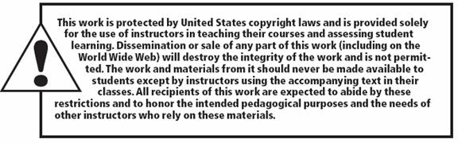
Copyright

